Slide 1
Presentation of the Program
Initial teaching residency program in Catalonia
Notes:
Fem 5 grups.
Cada grup aneu davant d’un dels murals penjats per la sala.
Anoteu-hi les reflexions que se us acudeixin en base a les preguntes establertes. Teniu X minuts.
Passat el temps, gireu a la dreta i aneu a buscar el següent mural. Afegiu-hi noves reflexions.
A la 3a ronda que feu, anoteu-hi més reflexions o comenteu el que ja han escrit els i les vostres companyes
Instruccions:
Hi ha 5 murals repartits per la sala.
A cada mural hi ha un TEMA relacionat amb les competències i pilars de la visió delxs mentorxs.
Generem 5 grups de 6-7 mentors.
Tothom passa per tots els murals???
Cadascú presenta el mural on s’ha quedat finalment.
Rol pels equips directius acompanyants: dires dels centres poden unir-se als grups O BÉ poden tenir un mural propi i 1r omplir-lo i dsp anar rondant. Els podem fer reflexionar sobre com han vist la implementació de NEST i com podrien donar-li CONTINUÏTAT (més enllà de Sensei).

Slide 2
The Sensei program..
It is a unique program in Spain , aimed at improving the experience of induction into the profession of new teachers and consolidating key skills for their professional career. The Spanish Ministry of Education is showing a lot of interest in this program.
We talk with all the agents involved, institutions included, to make the best program possible. The Sensei program is a pilot program, but even knowing that it will be improved by the contributions of the participants, we want to create a plan agreed upon with all agents.
Research shows that induction programs improve outcomes. Countries with better and more equitable educational outcomes have initial teacher residency programs, and have improved their rates of teacher satisfaction and well-being.
Notes:
Video 4: To understand the purpose and opportunities we will listen to different voices from the educational world.

Slide 3
Objectives of the Program:
Acord
GOV/69/2023
Accompany and support the novice teacher in the development of the practice educational within the framework of a culture of competence, collaborative and continuous learning.
Assign value to the center as a professional learning environment.
Recognize and professionalize the task of mentoring support.
Promote the self- regulatory evaluation of teaching learning.
Promote collaboration between the agents involved in the professional development of teachers.
Notes:
Carme

Slide 4
The center, a key part of the Sensei Program
The centers are the key piece in the success of induction into teaching. All of you lead centers that stand out for their good educational practices, which will enrich the experience of new teachers and help them achieve the skills our system needs.
Participation is essential to guarantee that teachers achieve skills that are key to responding to the challenges of the Catalan education system: improving the educational results of students and preventing and reducing early school leaving.
Notes:
Video 4: Per entendre el propòsit i les oportunitats escoltarem diferents veus del món educatiu.

Slide 5
Key aspects of the Program:
It takes place in 55 selected training schools for their experience with practice students and their training capacity.
Central role of 85 teaching mentors in the center, freed up to a maximum of half a teaching day who will be recognized for 250 hours of training.
It is offered voluntarily to 500 new teachers from the scholarship (250 in the school course 23-24 and 250 in the school year 24-25) based on an annual public call.
The program has the same effects as passing the Introductory Teaching Course.
It is a co-financed program by the European Union within the framework of the Catalonia Program 2023-2025 of the European Social Fund Plus, with a co-financing rate from the ESF of 95%.
Fase experimental | Dos cursos 2023 - 2025
total docents novells | 250
docents novells d’infantil i primària | 150
docents novells secundària | 100
centres del Programa | 60
Escoles- IE | 35
Instituts-IE | 25
docents mentors | 85

Slide 6
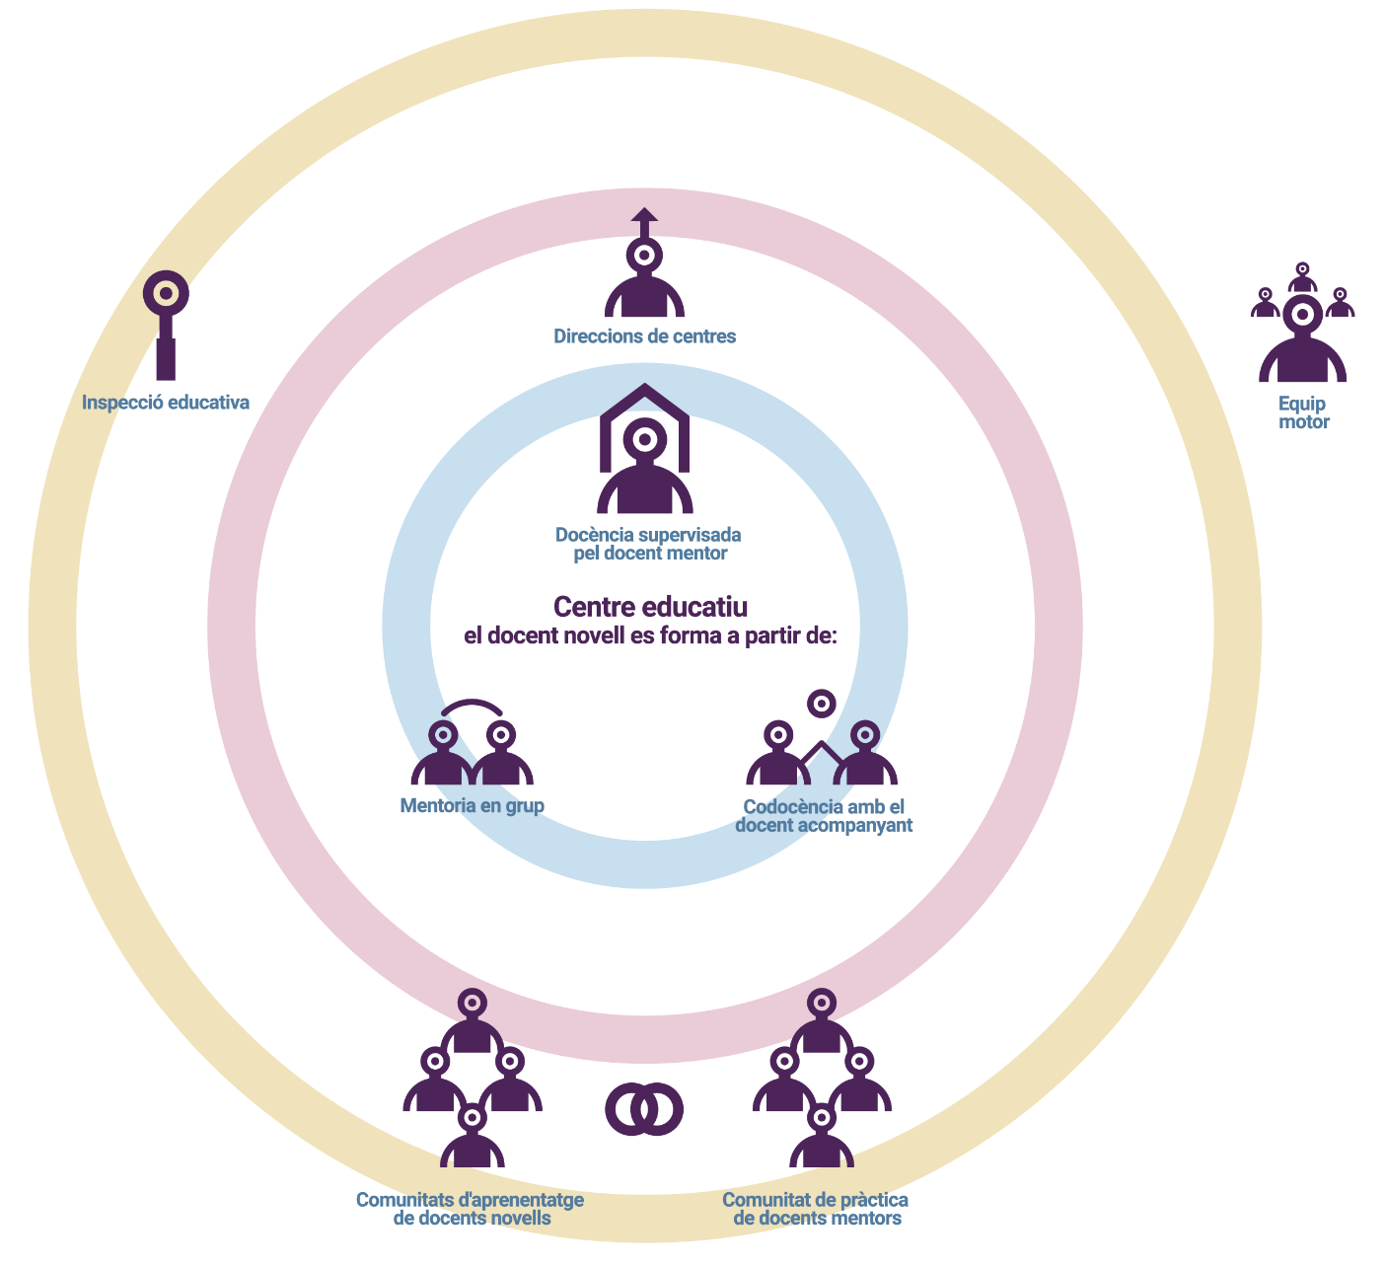
Map of agents involved:
Steering committees at the schools
Educational inspection
Management teams
Mentor teachers
novice teachers
Collaborating teachers, who implement co-teaching

Slide 7
Areas and Learning Objectives of the novice teacher
Catalan educational context. Integrate the identity features of the Catalan education system in the design and evaluation of educational action within the framework of the center project.
Updated learning practices. Develop up-to-date learning practices informed by evidence.
They address the most relevant professional teaching skills. The difference with the initial training is how it works: mobilizing all the learning and knowledge in practice , in different situations and contexts.
Classroom management. Generate a classroom climate that favors the participation, learning and personal development of students.
Evaluation. Develop the assessment for decision-making of student learning, as a teacher and as a team.
Professional development. Grow in a professional learning community that helps novice teachers develop their teaching identity.
Socio-emotional management. Incorporate strategies that promote a good socio-emotional climate for common well-being.

Slide 8
The methodological model of the Program
Cycles of observation, feedback and metacognition to make visible and self-regulate the learning process.
“Both parties benefit from the relationship
which must be horizontal”.
Supervised educational practice
Mentoring: The main objective is the learning and professional development of the participants, with a special emphasis on the professional development needs of the teacher who is starting his career. It is a formative and non-evaluative relationship. Both parties benefit from the relationship, which must in no case be hierarchical.
Professional learning circles
Notes:
Elena

Slide 9
The methodological model of the Program
Co-teaching will mean those teaching practices that include:
Two or more teachers working collaboratively with the same group of students,
who share the responsibility for student learning, both in the planning or design, as well as in the implementation of the sessions and the evaluation of this group of students and,
that have a shared vision for all students, that is to say, that they share learning.
Co-teaching
Support in the preparation of the teaching digital learning folder
Key tool for evaluation
Teaching digital learning folder
Notes:
Pere

Slide 10
Mentors training program
"Training support for teacher mentors"
Face to face training
Formative Pills
Professional learning community . Group training with novice teachers from other centers, led by external professionals and / or universities.
Universalitat del currículum
Aprenentatge informat en l’evidència (carpeta d’aprenentatge digital)
Taller de codocència
Four seven hour sessions
Notes:
Clara

Slide 11
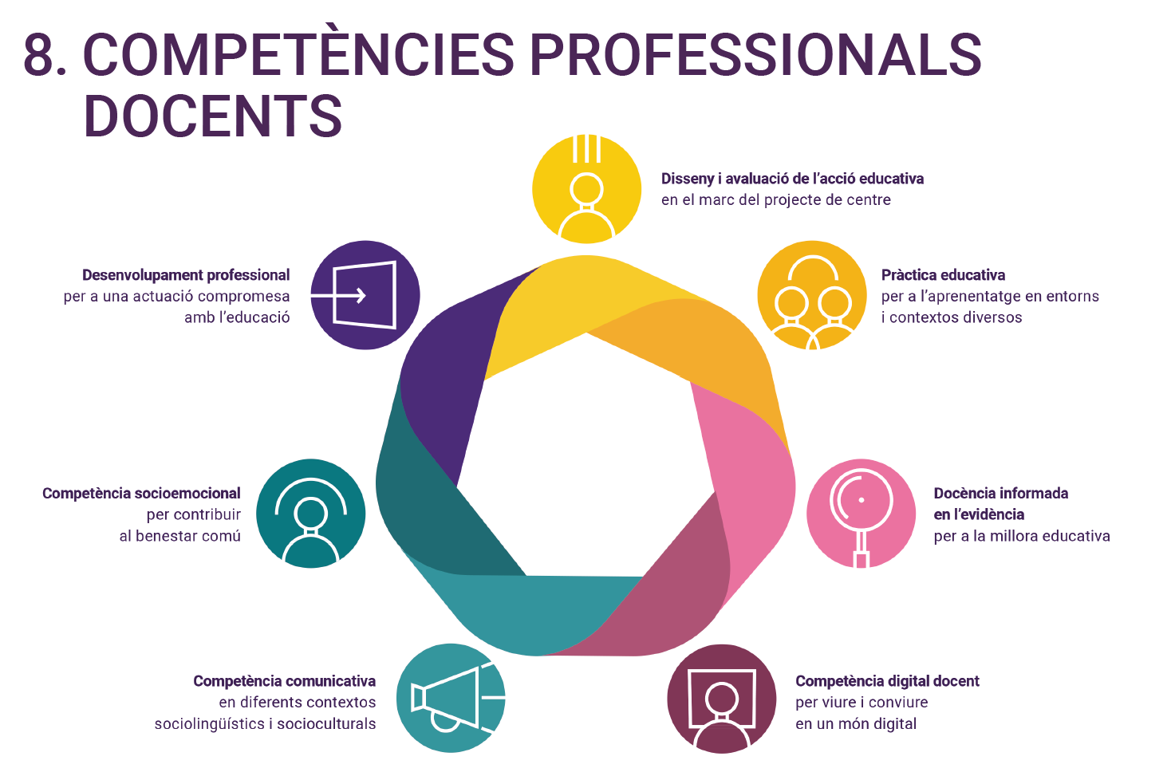
Teaching professional skills
Design and evaluation of the educational action according to the school project
Teacher’s professional development for a personal compromise with education.
Educational practice for learning in diverse environments and contexts
Socioemotional competence for the common wellbeing
Evidence-informed teaching for educational improvement
Communicative competence in different sociolinguistic and sociocultural contexts
Teaching digital competence to live and coexist in a digital world

Slide 12
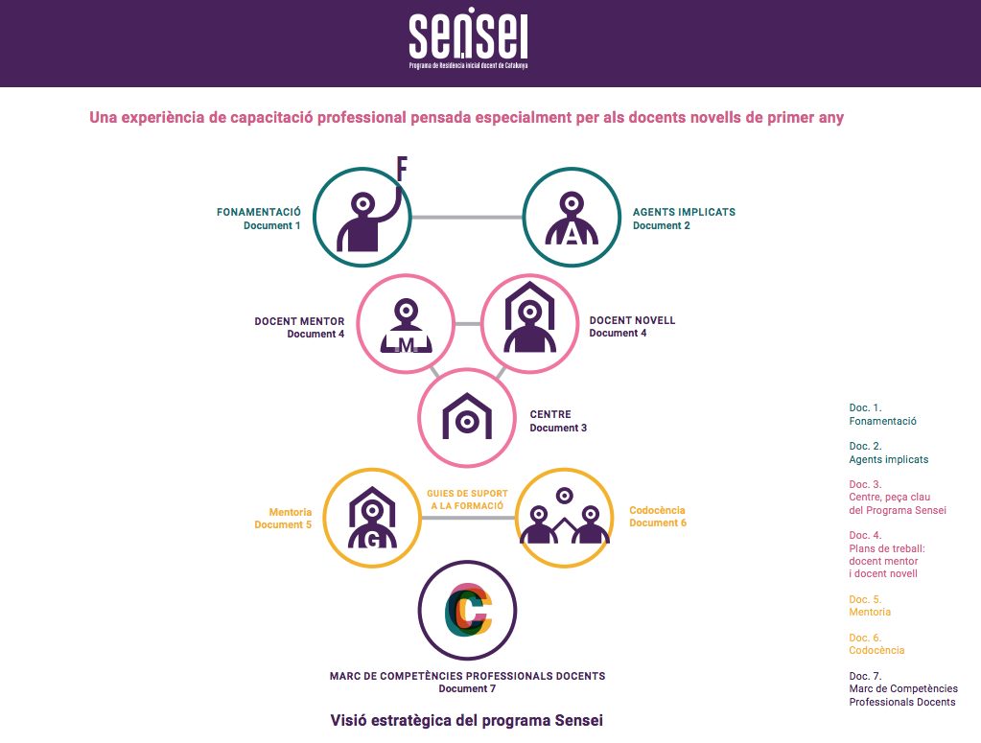
Published documents
Notes:
Video 4: Per entendre el propòsit i les oportunitats escoltarem diferents veus del món educatiu.

Slide 13
Novice teacher evaluation and support
"Tell me and I forget, show me and I remember, I get involved and I learn."
Benjamin Franklin
The evaluation is part of the learning process of the novice teacher
During the course of residence there will be different assessment methods
Formative
Formative
Competency-based evaluation
Accreditation Assessment
"It is aimed at helping the novice teacher in his own construction of knowledge’’
"To favor decision-making"
"It allows to identify the areas of improvement and progress as your competence learning progresses"
"Process to verify that the established criteria are met"
PASS / FAIL
They help the learning process
Notes:
David

Slide 14
Program Evaluation
"The evaluation of the program stands out for its transformative potential as a resource for self-reflection and professional improvement."
Comptarà amb la participació de:
Universities
Research Groups
School Community
Its purpose is to:
Generate evidences on the effectiveness and impact of the training measures developed during the period of initial teaching residency in schools.
Guide the training needs of the agents involved in the program
Report on the decision-making at three levels of the education system: teachers, centers and education policy.
Notes:
Lourdes

Slide 15
Transferència de coneixement
Participació en congressos
Publicacions en revistes d’àmbit educatiu
https://edoserveis-uab.cat/congreso2023/
Participació en jornades
Participació en programes europeus
Participació en recerca educativa
UVIC. LOOP és un projecte d’implementació de polítiques educatives que té com a objectiu contribuir al canvi cap a una política integral de professió docent que abasta totes les etapes de les seves carreres professionals
International Conference
SHARING AND LEARNING FOR MENTORING IN EDUCATION
ICSLME 2023
Notes:
Carme R

Slide 16
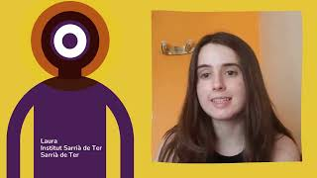

Slide 17
Initial teaching residency program in Catalonia
Notes:
Fem 5 grups.
Cada grup aneu davant d’un dels murals penjats per la sala.
Anoteu-hi les reflexions que se us acudeixin en base a les preguntes establertes. Teniu X minuts.
Passat el temps, gireu a la dreta i aneu a buscar el següent mural. Afegiu-hi noves reflexions.
A la 3a ronda que feu, anoteu-hi més reflexions o comenteu el que ja han escrit els i les vostres companyes
Instruccions:
Hi ha 5 murals repartits per la sala.
A cada mural hi ha un TEMA relacionat amb les competències i pilars de la visió delxs mentorxs.
Generem 5 grups de 6-7 mentors.
Tothom passa per tots els murals???
Cadascú presenta el mural on s’ha quedat finalment.
Rol pels equips directius acompanyants: dires dels centres poden unir-se als grups O BÉ poden tenir un mural propi i 1r omplir-lo i dsp anar rondant. Els podem fer reflexionar sobre com han vist la implementació de NEST i com podrien donar-li CONTINUÏTAT (més enllà de Sensei).

